Slide 1
Department of CSE Batch No: 4
DEPRESSION DETECTION
USING ECG
Presented By: Under the guidance of
B. BASKAR RAJU(217R1A0513) Mr. G. VINESH SHANKAR
B. NARSIMHA(217R1A0507) Assistant Professor
S. VINAYAK (217R1A0554)

Slide 2
Introduction
DEPRESSION is a common mental disorder that affects approximately more than 350 million people worldwide.
Major depression significantly affects a person's family, personal relationships and other general health aspects. It is reported by the World Health Organization that depression will become the second leading cause of illness by the year 2020.
However, the assessment methods of diagnosing depression rely almost exclusively on patientreported or clinical judgments of symptom severity
Current diagnostic techniques of depression have obvious disadvantages, which are associated with patient denial, poor sensitivity, subjective biases and inaccuracy
All these disadvantages make depression diagnosis a labor intensive work.
Recently, machine learning approaches have been applied to bio-signals for depression detection. However, there is still a gap between the classification accuracy and the actual application scenarios.

Slide 3
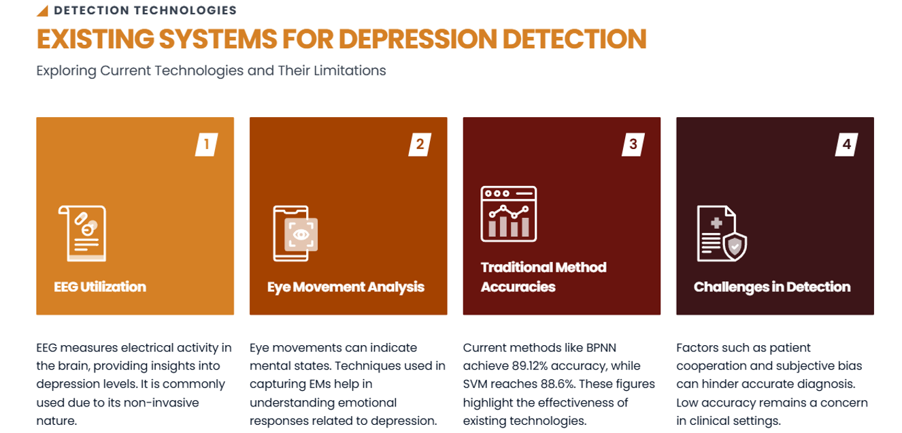

Slide 4
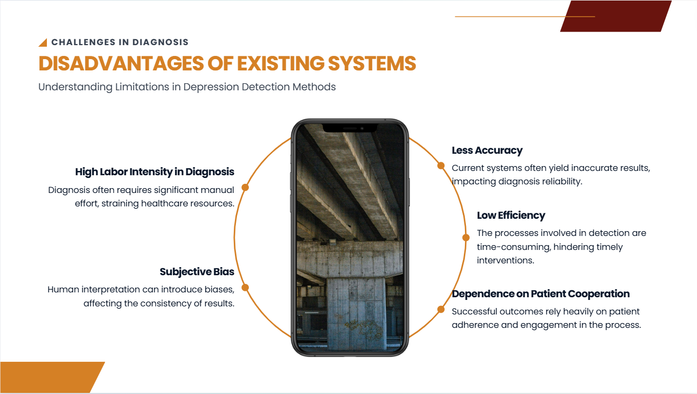

Slide 5
Proposed System
To implement this project we are using python Speech Recognition API which will read text from audio files and then SVM will analyse that text to detect depression, user can also upload images via post and python Tesseract OCR (Optical Character Recognition) API can read text from uploaded image and then SVM will detect depression from that text, User can upload post in text file also.

Slide 6
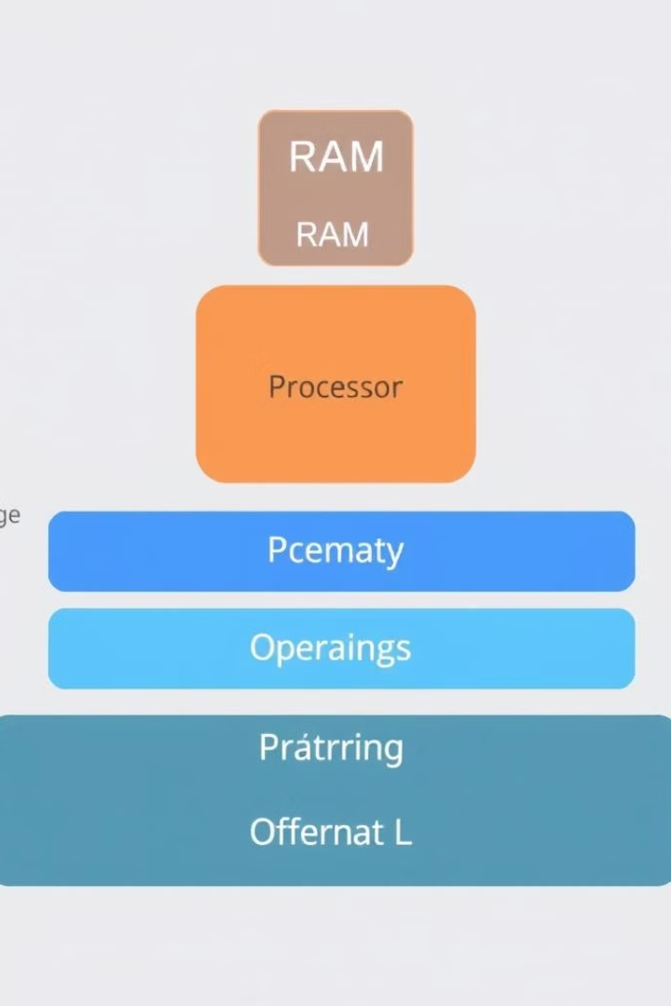
Hardware and Software Requirements
Hardware
System : i5 or above.
Ram : 8 GB
Hard Disk : 512 GB
Software
Operating system : Windows 8 or Above.
Coding Language : Python 3.0.7

Slide 7
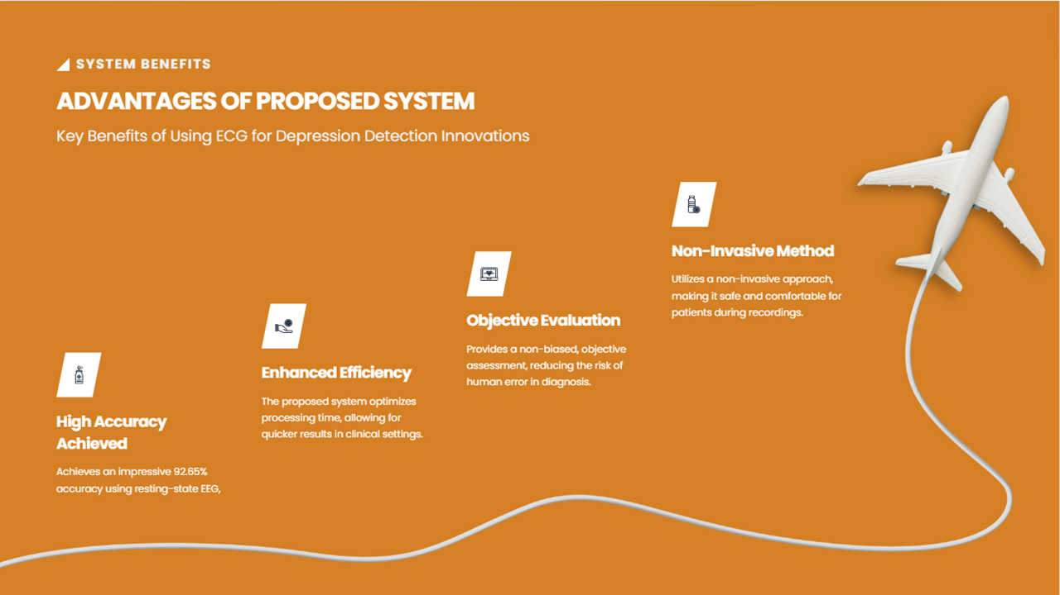

Slide 8


Slide 9
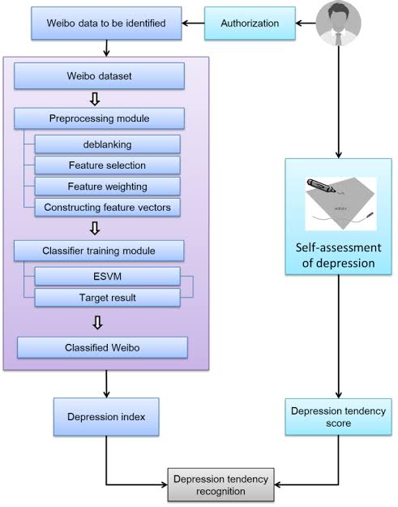
System Architecture:

Slide 10
MODULES
Admin Module:
Administrator will login to application using username as ‘admin’ andpassword ‘admin’. After login admin can view all registered users and all posts send by eachusers. Admin can send motivation messages to all depressed users. All positive and negativedepression users can also be seen in the form of graph.
User Module:
Users need to register with the application and then login to application to access various sub modules such as
Search Friends:
Using this module user can see all peoples register with the application
Upload Posts:
Using this module user can upload post in various formats such as text file,image or audio file. This application accepts only .WAV file format.

Slide 11
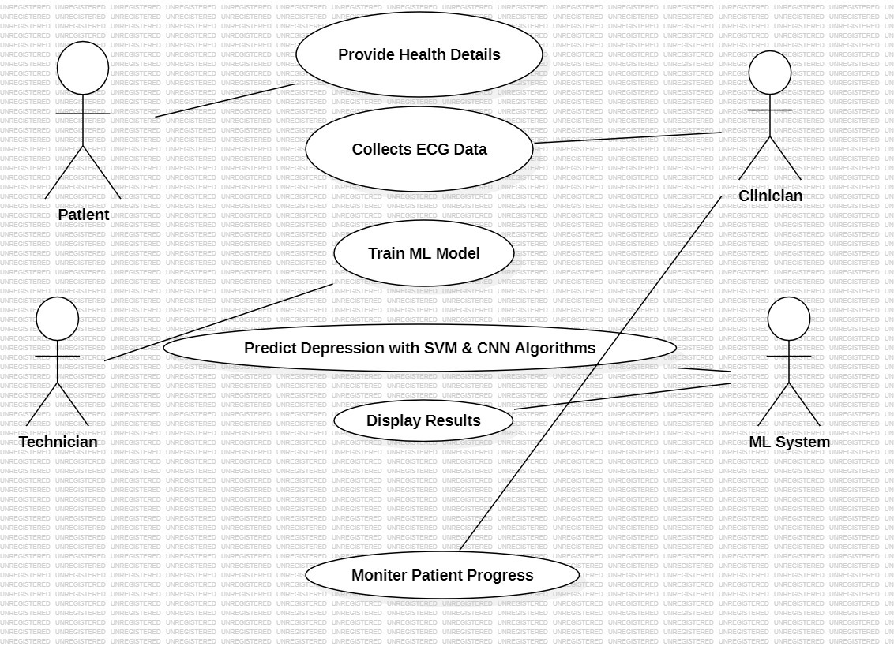
UML Diagrams
Use Case Diagram:

Slide 12
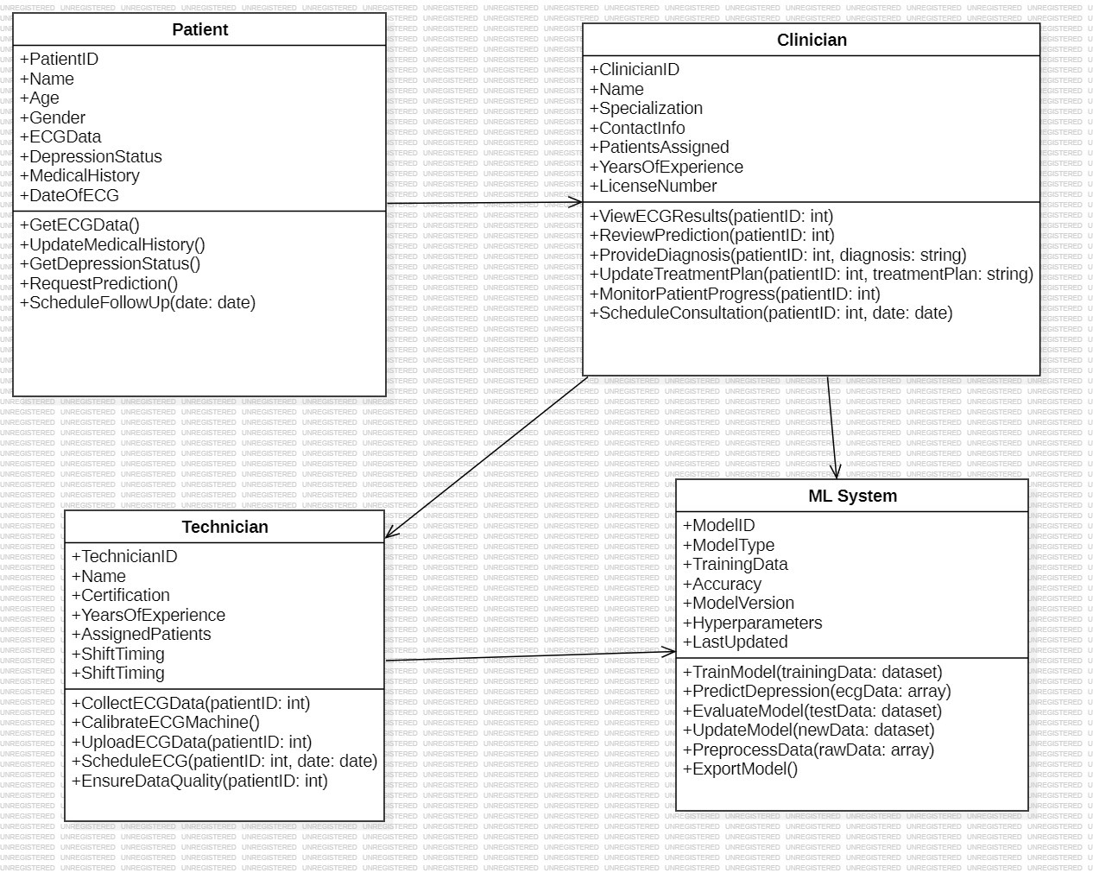
Class Diagram:

Slide 13
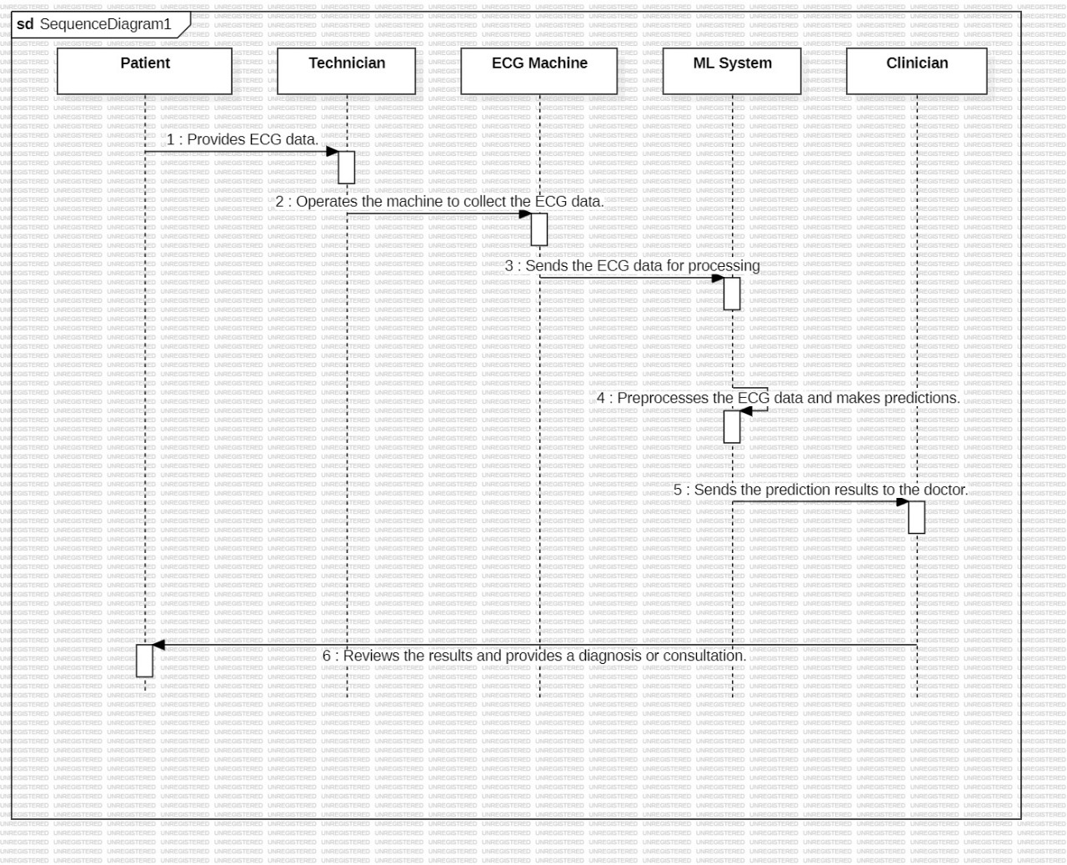
Sequence diagram:

Slide 14
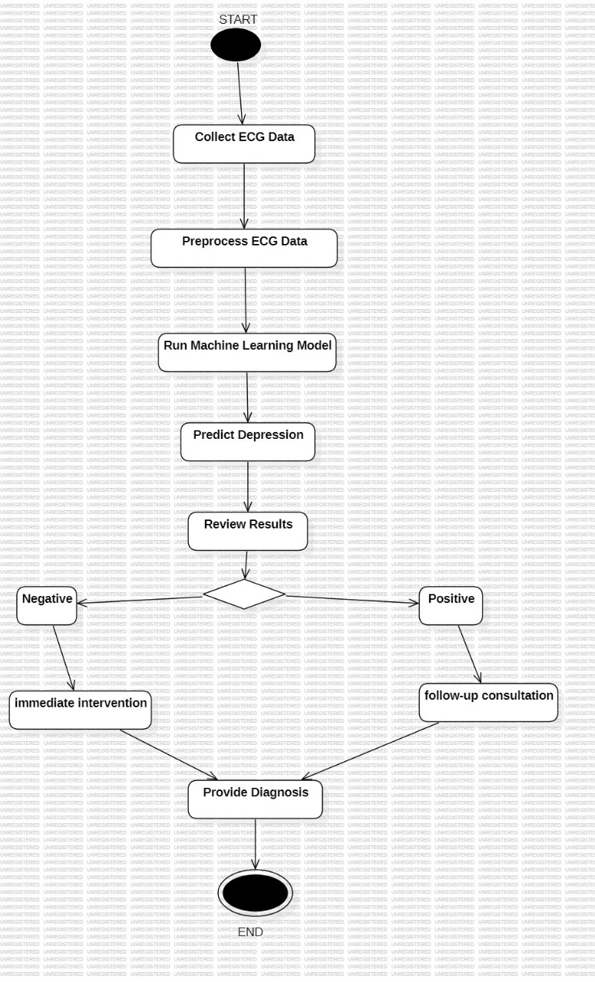
Activity diagram:

Slide 15
Sample Code:
__init__.py
import pymysql
print(pymysql.__file__)
pymysql.install_as_MySQLdb()
Admin.py
from django.contrib import admin
# Register your models here.
Models.py
import pymysql
print(pymysql.__file__)
pymysql.install_as_MySQLdb()

Slide 16
tests.py
from django.test import TestCase
# Create your tests here.
settings.py
import os#
Build paths inside the project like this: os.path.join(BASE_DIR, ...)
BASE_DIR = os.path.dirname(os.path.dirname(os.path.abspath(_file_)))
# Quick-start development settings - unsuitable for production
# See https://docs.djangoproject.com/en/2.2/howto/deployment/checklist/
# SECURITY WARNING: keep the secret key used in production secret!SECRET_KEY = '%8f!97e_yfkjc*t1s2@p6f1z531f*fm0t@2dmo9p74q#!tza%u’
# SECURITY WARNING: don't run with debug turned on in production!DEBUG = True

Slide 17
ALLOWED_HOSTS = []
# Application definitionINSTALLED_APPS = [ 'django.contrib.admin', 'django.contrib.auth', 'django.contrib.contenttypes', 'django.contrib.sessions', 'django.contrib.messages', 'django.contrib.staticfiles', 'DepressionApp’]
MIDDLEWARE = [ 'django.middleware.security.SecurityMiddleware', 'django.contrib.sessions.middleware.SessionMiddleware', 'django.middleware.common.CommonMiddleware', 'django.middleware.csrf.CsrfViewMiddleware', 'django.contrib.auth.middleware.AuthenticationMiddleware', 'django.contrib.messages.middleware.MessageMiddleware', 'django.middleware.clickjacking.XFrameOptionsMiddleware’,]
ROOT_URLCONF = 'Depression.urls’
TEMPLATES = [ { 'BACKEND': 'django.template.backends.django.DjangoTemplates', 'DIRS': [ os.path.join('C:/Python/Depression/DepressionApp', 'templates'), ], 'APP_DIRS': True, 'OPTIONS': { 'context_processors': [ 'django.template.context_processors.debug', 'django.template.context_processors.request', 'django.contrib.auth.context_processors.auth', 'django.contrib.messages.context_processors.messages', ], }, },]
WSGI_APPLICATION = 'Depression.wsgi.application’
CACHES = { 'default': { 'BACKEND': 'django.core.cache.backends.filebased.FileBasedCache', 'LOCATION': 'C:/cache/django_cache.txt', }}

Slide 18
# Database
# https://docs.djangoproject.com/en/2.2/ref/settings/#databases
DATABASES = { 'default': { 'ENGINE': 'django.db.backends.mysql', 'NAME': 'depression', 'HOST': '127.0.0.1', 'PORT': '3306', 'USER': 'root', 'PASSWORD': 'root', 'OPTIONS': { 'auto commit': True, }, }}
# Password validation
# https://docs.djangoproject.com/en/2.2/ref/settings/#auth-password-validatorsAUTH_PASSWORD_VALIDATORS = [ { 'NAME': 'django.contrib.auth.password_validation.UserAttributeSimilarityValidator', }, { 'NAME': 'django.contrib.auth.password_validation.MinimumLengthValidator', }, { 'NAME': 'django.contrib.auth.password_validation.CommonPasswordValidator', }, { 'NAME': 'django.contrib.auth.password_validation.NumericPasswordValidator', },]
# Internationalization
# https://docs.djangoproject.com/en/2.2/topics/i18n/
LANGUAGE_CODE = 'en-us’
TIME_ZONE = 'UTC’
USE_I18N = True
USE_L10N = True
USE_TZ = True# Static files (CSS, JavaScript, Images)
# https://docs.djangoproject.com/en/2.2/howto/static-files/STATIC_URL = '/static/'

Slide 19
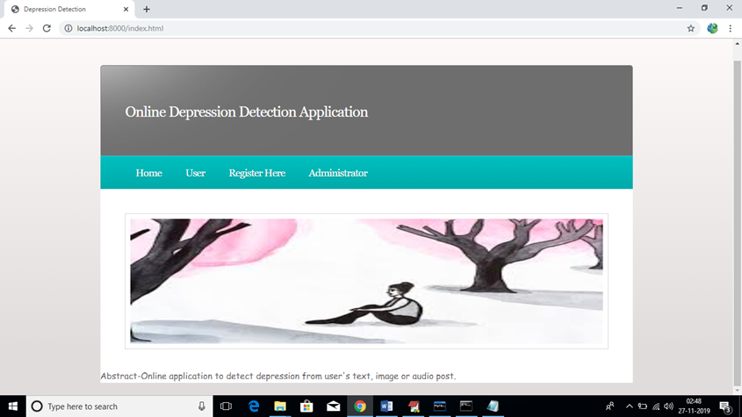
Result:
Data upload

Slide 20
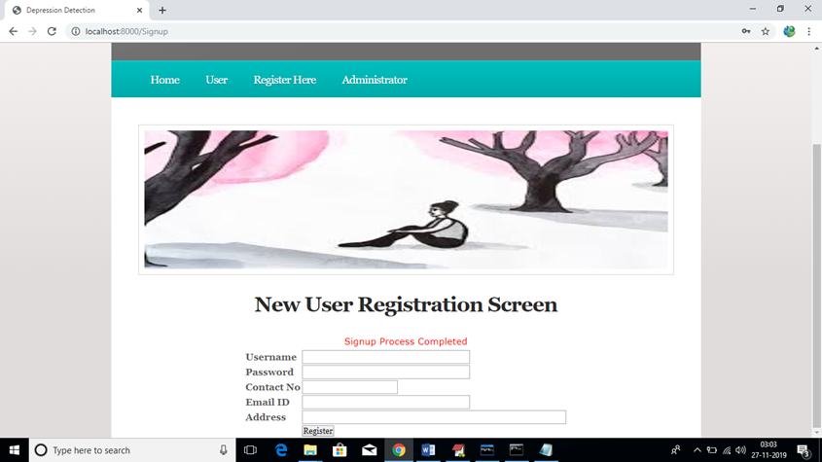
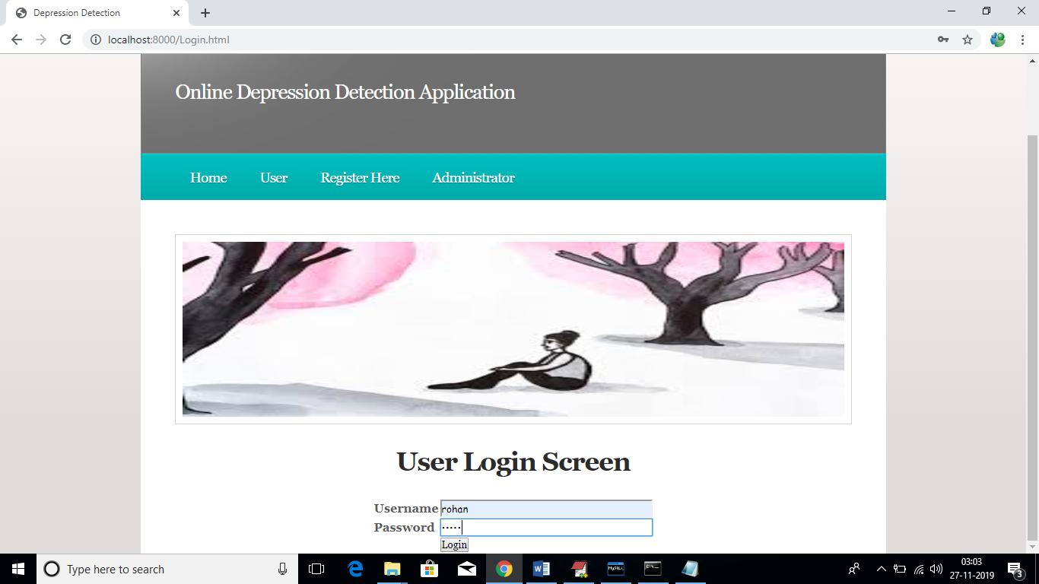
New User Registration
User Login Screen

Slide 21
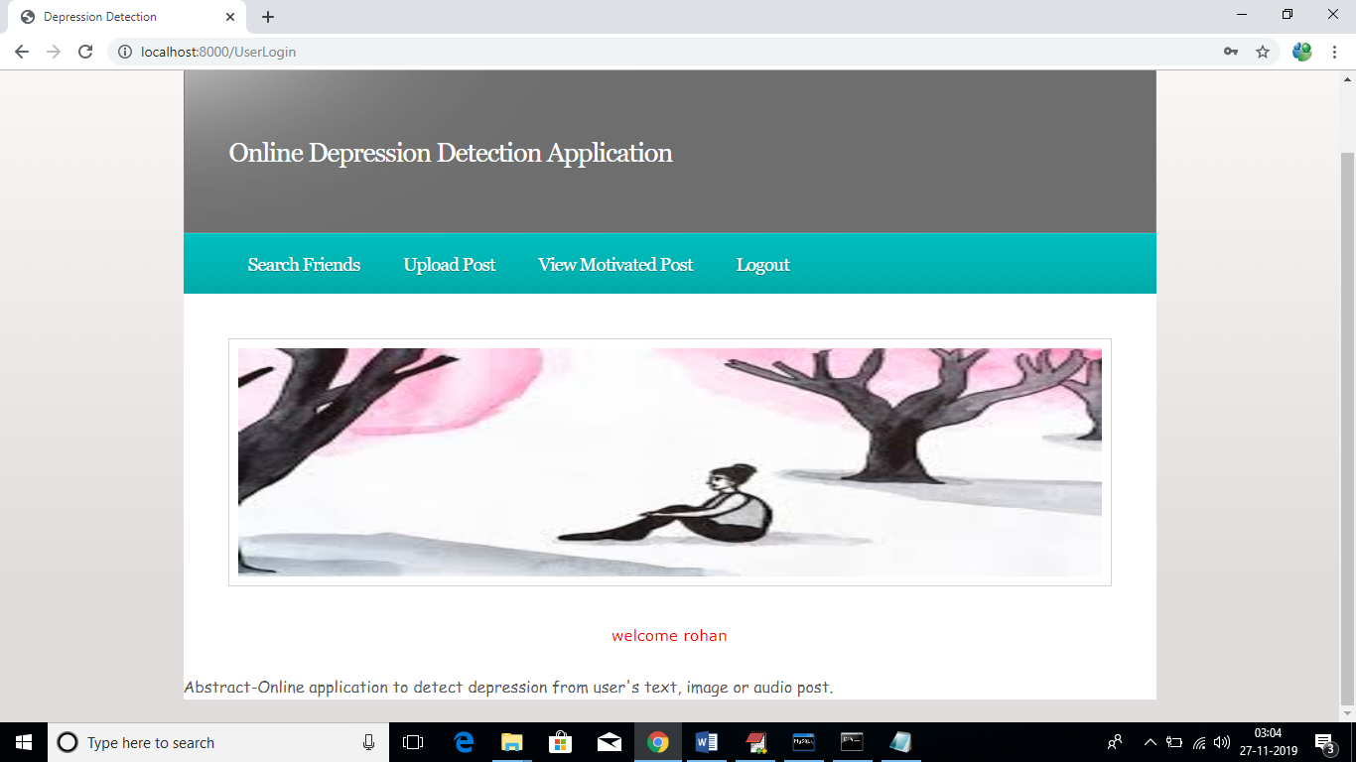
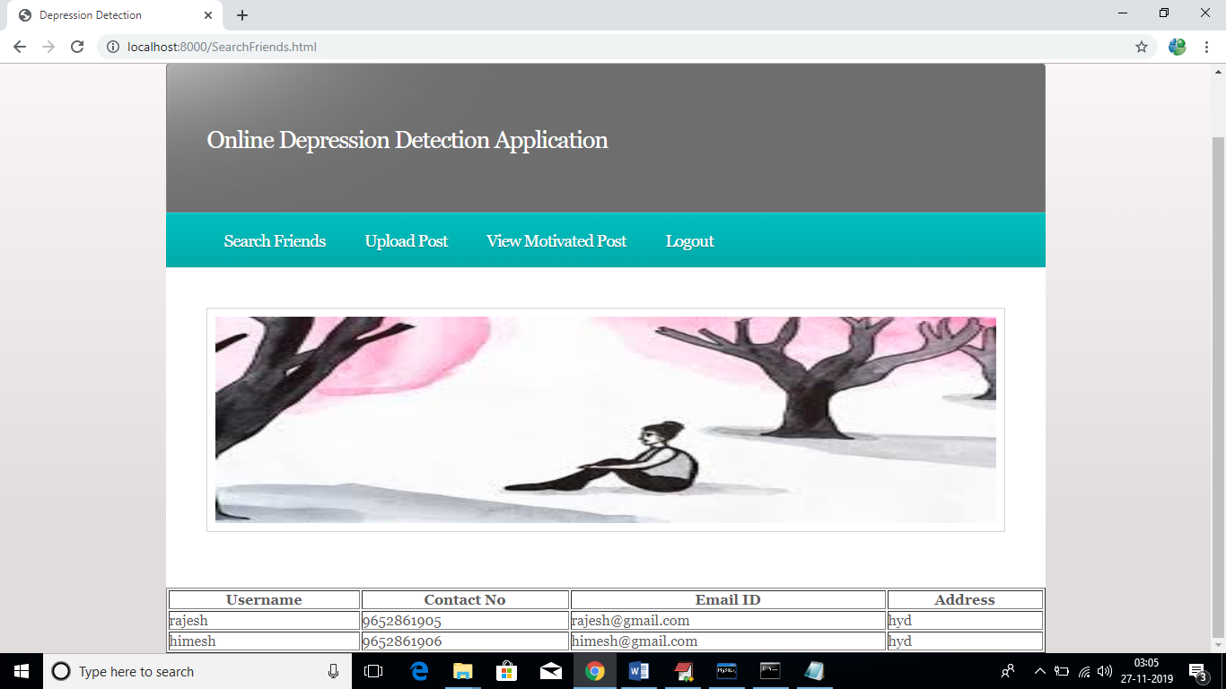
Welcome User
Display User Details

Slide 22
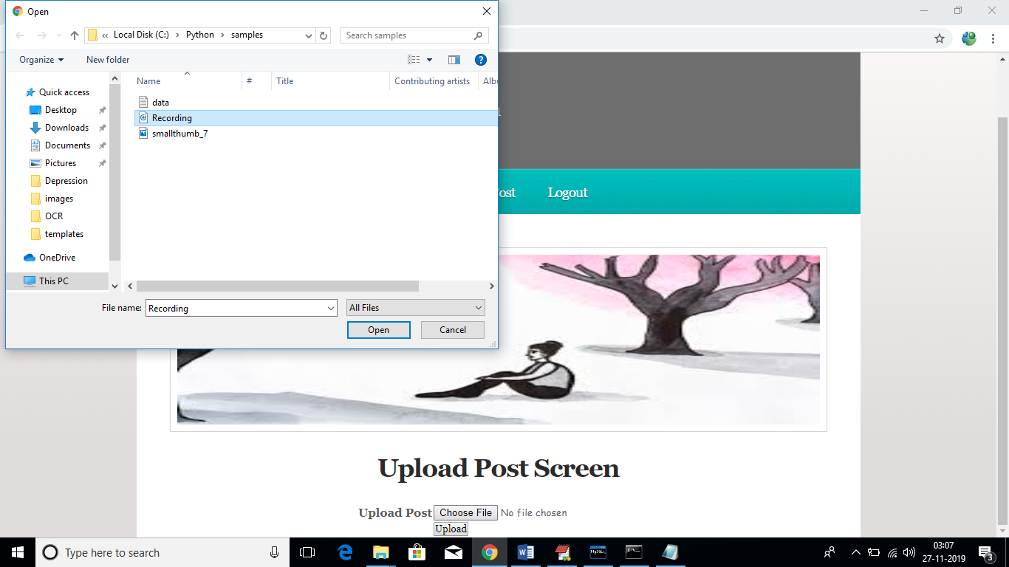

Upload Dataset
Depression Detection

Slide 23
Conclusion
In this paper, we tried to identify the presence of depression in Reddit social media; and searched for affective performance increase solutions of depression detection. We characterized a closer connection between depression and a language usage by applying NLP and text classification techniques. We identified a lexicon of words more common among the depressed accounts. According to our findings, the language predictors of depression contained the words related to preoccupation with themselves, feelings of sadness, anxiety, anger, hostility or suicidal thoughts, with a greater emphasis on the present and future

Slide 24
Future Scope
In the future, with the purpose of better understanding EEG and EMs data in the domain of depression recognition, we will continually explore efficient bio-signal data mining methods, especially, we will dedicate to improve the ensemble method, and explore new strategy to alternate the existing voting system.

Slide 25
References
[1]M. Marcus, M. T. Yasamy, M. van Ommeren, D. Chisholm, and S. Saxena, “Depression: A global public health concern,” WHO Department of Mental Health and Substance Abusevol. 1, pp. 6-8, 2012.
[2] G. H. Brundtland, “Mental health: new understanding, new hope,” Jama, vol. 286, no. 19, pp. 2391-2391, 2001.
[3] J. C. Mundt, P. J. Snyder, M. S. Cannizzaro, K. Chappie, and D. S. Geralts, “Voice acoustic measures of depression severity and treatment response collected via interactive voice response (IVR) technology,” Journal of neurolinguistics, vol. 20, no. 1, pp. 50-64, 2007.
[4] M. Sung, C. Marci, and A. Pentland, “Objective physiological and behavioral measures for identifying and tracking depression state in clinically depressed patients,” Massachusetts Institute of Technology Media Laboratory, Cambridge, MA, Tech. Rep. TR, vol. 595, 2005.
[5] L. Liu, R. Zhou, and D. O. Psychology, “An Important Neural Indicator of Measuring Depression: The Asymmetry of Resting Frontal Activity,” Advances in Psychological Science, vol. 23, no. 6, pp. 1000, 2015.
[6] J. Joshi, R. Goecke, S. Alghowinem, A. Dhall, M. Wagner, J. Epps, G. Parker, and M. Breakspear, “Multimodal assistive technologies for depression diagnosis and monitoring,” Journal on Multimodal User Interfaces, vol. 7, no. 3, pp. 217-228, 2013.
[7] P. Giannakopoulos, P. Missonnier, G. Gold, and A. Michon, “Electrophysiological Markers of Rapid Cognitive Decline in Mild Cognitive Impairment,” Frontiers of Neurology & Neuroscience, vol. 24, pp. 39, 2009.
[8] G. M. BAIRY, U. C. NIRANJAN, and S. D. PUTHANKATTIL, “AUTOMATED CLASSIFICATION OF DEPRESSION EEG SIGNALS USING WAVELET ENTROPIES AND ENERGIES,” Journal of Mechanics in Medicine & Biology, vol. 16, no. 03, pp. 13 pages, 2016.

Slide 26
Github Link:
https://github.com/narsimha/depression-detection-using-ecge

Slide 27

Thank you
By Batch 4
CSE

